Slide 1
Localizing Handle-Like Grasp Affordance in 3D Point Clouds
Presenter:
Jiatao Fan
Article authors:
Andreas ten Pas and Robert Platt
Publication Venue:
ISRR, 2014

Slide 2
Overview
Introduction
Process of localizing Grasp Affordances
Approximating object surface
Fitting a cylindrical shell around the object
Optimization
Experiment result
Conclusion and future work

Slide 3
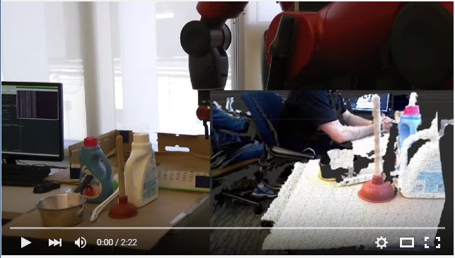
1. Introduction: Demo

Slide 4
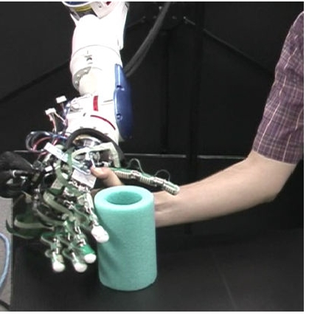
1. Introduction: Key Definition
Grasp affordance geometries:
object geometries that can be grasped in a particular way by a particular robot hand.

Slide 5
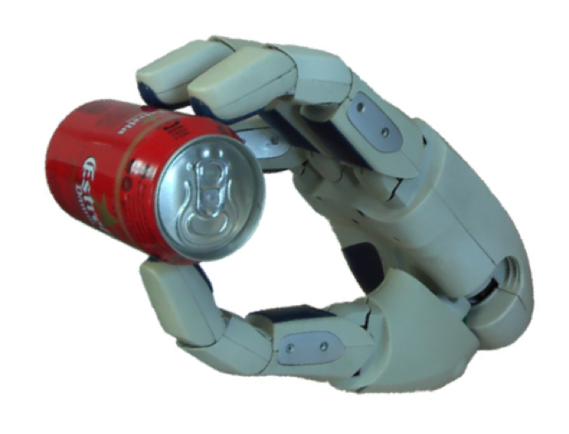
1. Introduction: Key Definition
Enveloping grasp affordance geometries:
An enveloping grasp affordance is a handle-like object geometry that can be grasped by encircling it with the “thumb and fingers” of the robot hand.

Slide 6
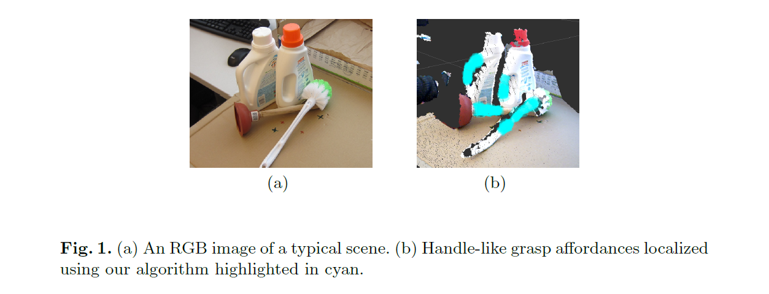
1. Introduction: Goal & Idea
Goal: localize handle-like grasp affordances in 3-D point clouds.
Idea: Identify a set of geometric conditions for a grasp affordance and search the point cloud for neighborhoods that satisfy these conditions.

Slide 7
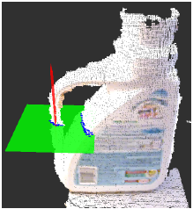
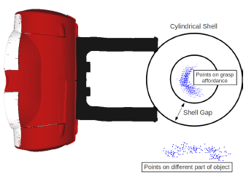
2. Process of localizing Grasp Affordances
Generic algorithm:
Sample spherical point neighborhoods
Fit an implicit polynomial surface
Measure magnitudes and axes of principal surface curvature
Project the point neighborhoods onto a plane orthogonal to the axis of minor principal curvature
Fit a circle to the projected points
Construct a cylindrical shell to enclose the object surface

Slide 8
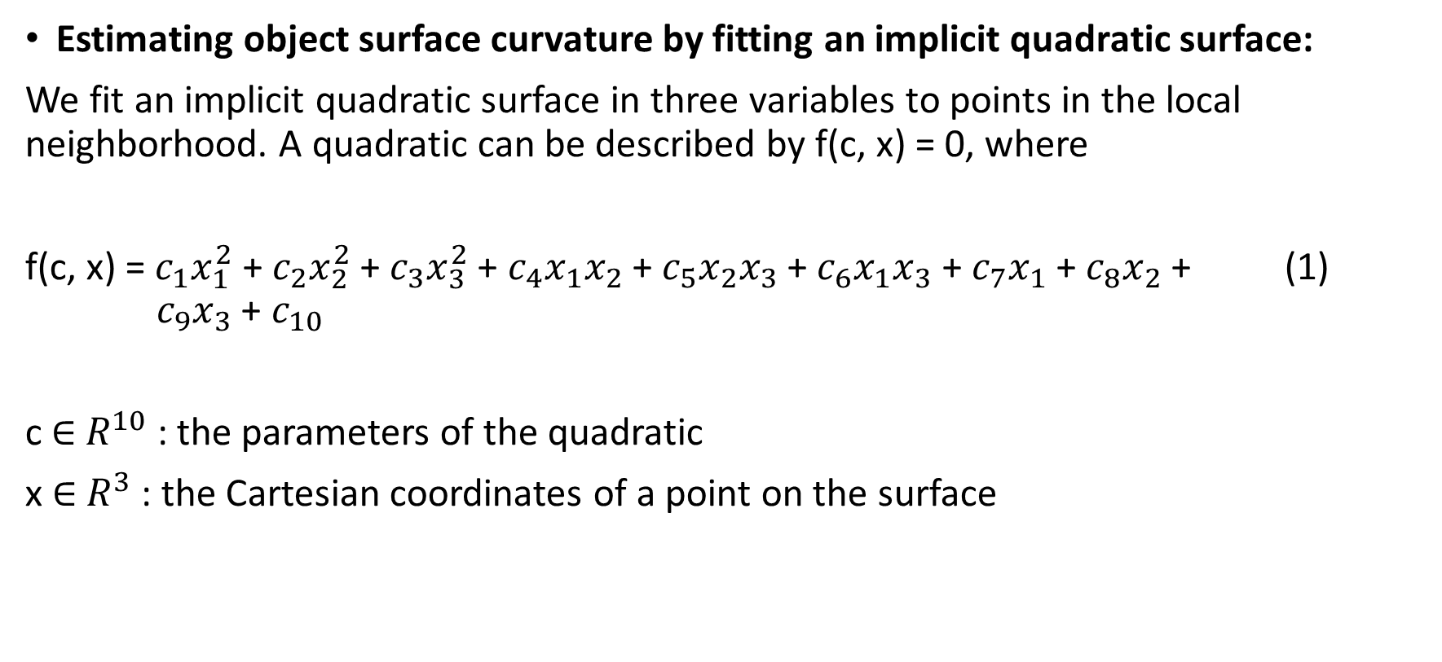
2. Process of localizing Grasp Affordances
Estimating object surface curvature by fitting an implicit quadratic surface:
We fit an implicit quadratic surface in three variables to points in the local neighborhood. A quadratic can be described by f(c, x) = 0, where
f(c, x) = $c_{1}x_{1}^{2}$ + $c_{2}x_{2}^{2}$ + $c_{3}x_{3}^{2}$ + $c_{4}x_{1}x_{2}$ + $c_{5}x_{2}x_{3}$ + $c_{6}x_{1}x_{3}$ + $c_{7}x_{1}$ + $c_{8}x_{2}$ + (1) $c_{9}x_{3}$ + $c_{10}$
c $∈$ $R^{10}$ : the parameters of the quadratic
x $∈$ $R^{3}$ : the Cartesian coordinates of a point on the surface

Slide 9
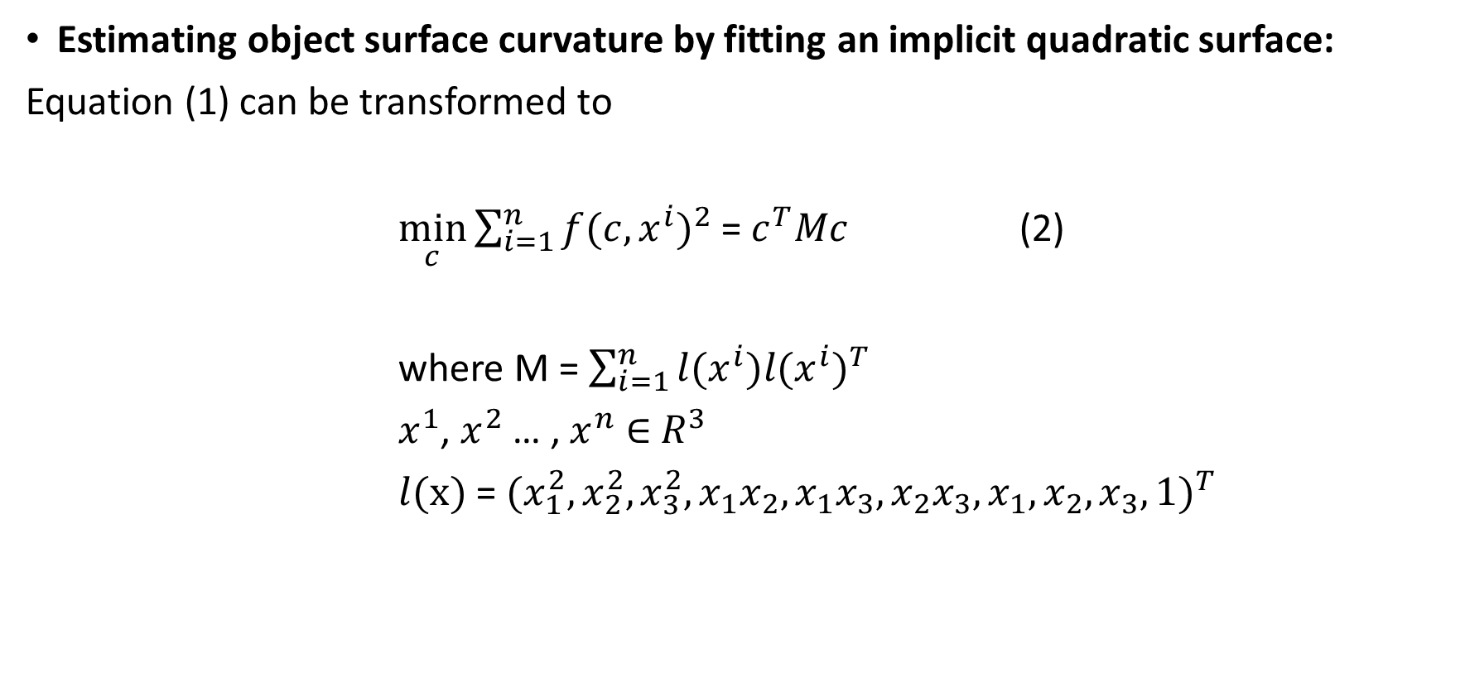
2. Process of localizing Grasp Affordances
Estimating object surface curvature by fitting an implicit quadratic surface:
Equation (1) can be transformed to
$\min_{c}{\sum_{i=1}^{n}{{f(c, x^{i})}^{2}}}$ = $c^{T}Mc$ (2)
where M = $\sum_{i=1}^{n}{{l(x^{i})l(x^{i})}^{T}}$
$x^{1}$, $x^{2}$ … , $x^{n}$ $∈$ $R^{3}$
$l(x)$ = ${(x_{1}^{2},x_{2}^{2},x_{3}^{2},x_{1}x_{2},x_{1}x_{3},x_{2}x_{3},x_{1}, x_{2},x_{3}, 1)}^{T}$

Slide 10
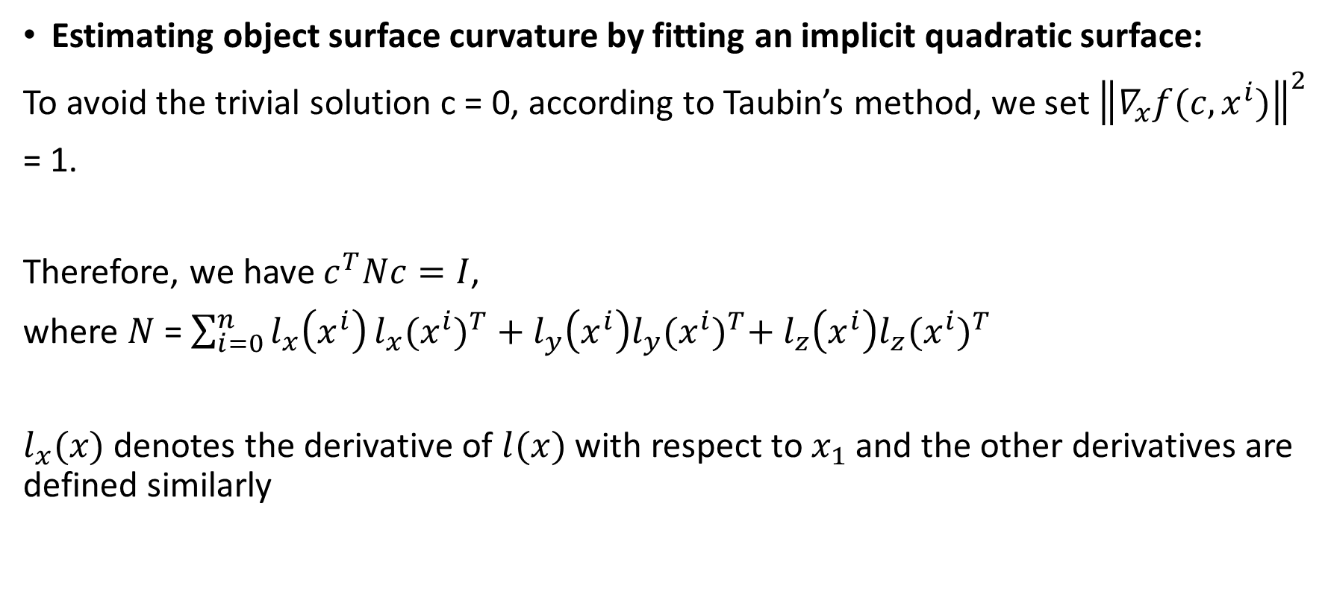
2. Process of localizing Grasp Affordances
Estimating object surface curvature by fitting an implicit quadratic surface:
To avoid the trivial solution c = 0, according to Taubin’s method, we set ${\left\|∇_{x}f(c, x^{i})\right\|}^{2}$
= 1.
Therefore, we have $c^{T}Nc=I$,
where $N$ = $\sum_{i=0}^{n}{l_{x}\left(x^{i}\right)}l_{x}{(x^{i})}^{T} + l_{y}\left(x^{i}\right)l_{y}{(x^{i})}^{T}+ l_{z}\left(x^{i}\right)l_{z}{(x^{i})}^{T}$
$l_{x}(x)$ denotes the derivative of $l(x)$ with respect to $x_{1}$ and the other derivatives are defined similarly

Slide 11
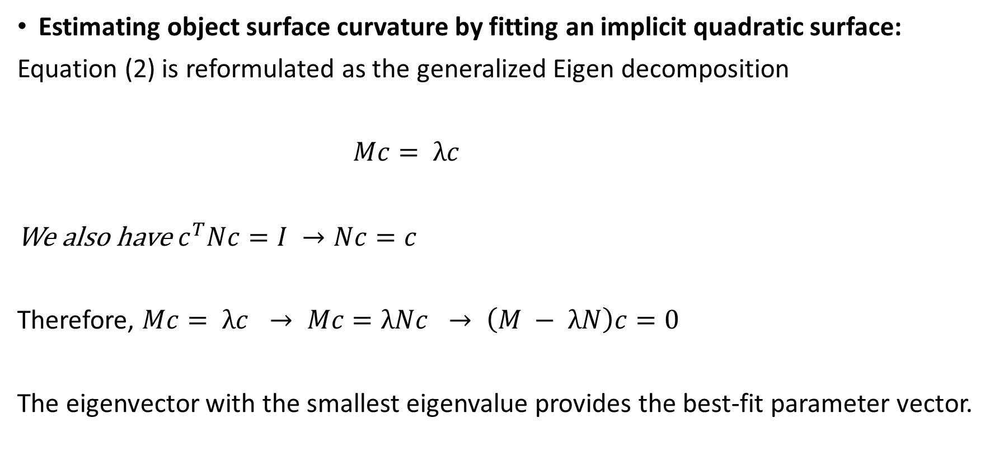
2. Process of localizing Grasp Affordances
Estimating object surface curvature by fitting an implicit quadratic surface:
Equation (2) is reformulated as the generalized Eigen decomposition
$Mc= λc$
We also have $c^{T}Nc=I →Nc=c$
Therefore, $Mc= λc → Mc=λNc → \left(M − λN\right)c=0$
The eigenvector with the smallest eigenvalue provides the best-fit parameter vector.

Slide 12
2. Process of localizing Grasp Affordances
Estimating object surface curvature by fitting an implicit quadratic surface:
To fix the axis of the cylindrical shell to lie along the axis of minor principal curvature, we need
magnitude and direction of the curvature of the quadratic surface

Slide 13
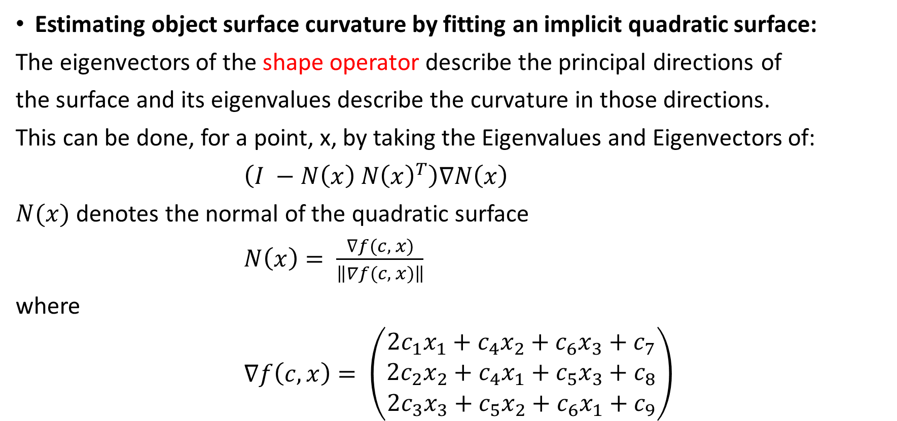
2. Process of localizing Grasp Affordances
Estimating object surface curvature by fitting an implicit quadratic surface:
The eigenvectors of the shape operator describe the principal directions of
the surface and its eigenvalues describe the curvature in those directions.
This can be done, for a point, x, by taking the Eigenvalues and Eigenvectors of:
$\left(I −N\left(x\right) N{\left(x\right)}^{T}\right)∇N\left(x\right)$
$N(x)$ denotes the normal of the quadratic surface
$N\left(x\right)= \frac{∇f(c, x)}{\left\|∇f(c, x)\right\|}$
where
$∇f\left(c, x\right)= \left(\begin{matrix}2c_{1}x_{1}+c_{4}x_{2}+c_{6}x_{3}+c_{7} \\ 2c_{2}x_{2}+c_{4}x_{1}+c_{5}x_{3}+c_{8} \\ 2c_{3}x_{3}+c_{5}x_{2}+c_{6}x_{1}+c_{9}\end{matrix}\right)$

Slide 14
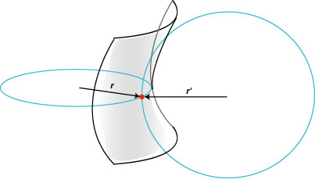
2. Process of localizing Grasp Affordances
Estimating object surface curvature by fitting an implicit quadratic surface:
All enveloping grasp affordances are located in a high-curvature neighborhood, so we eliminate all neighborhoods with an associated surface curvature below some parametrized threshold.

Slide 15
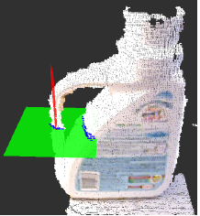
2. Process of localizing Grasp Affordances
Cylindrical shell search:
1. Project the points in the local neighborhood onto the plane orthogonal to the minor principal curvature axis

Slide 16
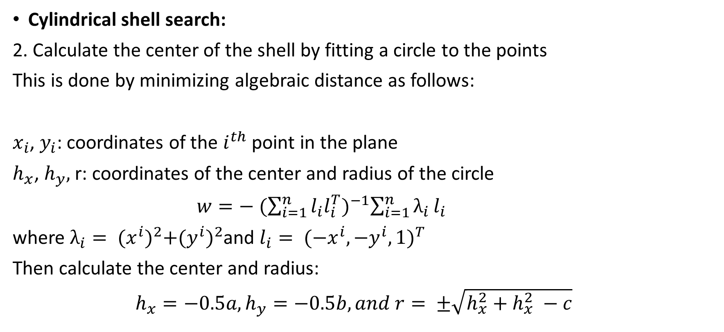
2. Process of localizing Grasp Affordances
Cylindrical shell search:
2. Calculate the center of the shell by fitting a circle to the points
This is done by minimizing algebraic distance as follows:
$x_{i}$, $y_{i}$: coordinates of the $i^{th}$ point in the plane
$h_{x}$, $h_{y},$r: coordinates of the center and radius of the circle
$w=− {(\sum_{i=1}^{n}{l_{i}l_{i}^{T}})}^{−1}\sum_{i=1}^{n}{λ_{i}}l_{i}$
where $λ_{i}= {(x^{i})}^{2}+{(y^{i})}^{2}$and $l_{i}= {({−x}^{i},{−y}^{i},1)}^{T}$
Then calculate the center and radius:
$h_{x}=−0.5a, h_{y}=−0.5b, and r= ±\sqrt{h_{x}^{2}+h_{x}^{2} −c}$

Slide 17
2. Process of localizing Grasp Affordances
Cylindrical shell search:
3. Fix the center of the shell to the center of the circle & use brute-force 1-D search to search over different radii for a shell such that:
the gap contains no points
the radius of the inner cylinder is less
than the diameter of the robot hand

Slide 18
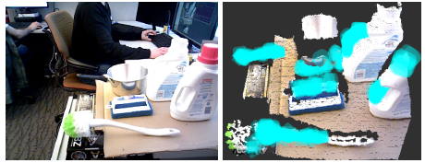
3. Optimization
Handle search:
The presence of an enveloping grasp affordance guarantees that a grasp is possible as long as all object surfaces in the local area are densely covered with points.
Not always the case!

Slide 19
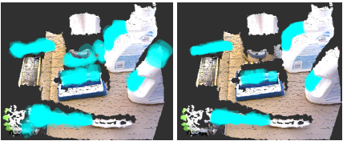
3. Optimization
Handle search:
Solution:
Search for sets of enveloping grasp affordances that form “handles”, i.e. sets of affordances that are roughly aligned and that cover some minimum length.

Slide 20
3. Optimization
Sampling strategy:
sequential importance sampling:
Samples a fixed number of point neighborhoods in a series of rounds.
In the 1st round, neighborhoods are chosen uniformly at random from the point cloud
After the 1st round, samples are drawn from a proposal distribution parametrized by the positions of the enveloping grasp affordances found in all prior rounds.

Slide 21
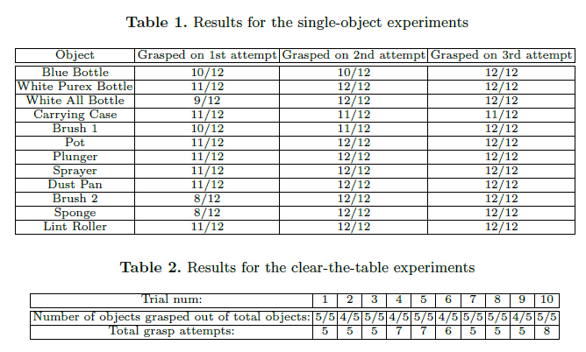
4. Experiment result
Localization:

Slide 22
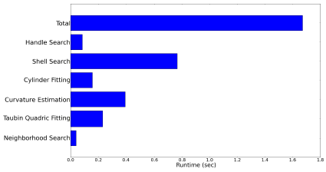
4. Experiment result
Runtime :

Slide 23
5. Conclusion & Future Work
The paper proposes a new robust and fast approach to localize handle-like grasp affordances in 3-D point clouds.
The brute-force search for handles occupied the most of the total running time, so possible future direction may be finding a closed-form approximation to the brute-force search that would further reduce running time.

